Slide 1


ECEN 403
Creating STEM Contents: Solar Power with a Tracking System
Final Update Presentation
Leo Predanic
George Thuita
Brandon Cenci
Sponsor: Dr. Won Jang
TA: Sambandh Dhal

Slide 2

Executive Summary
Problem statement:
To create the future of tomorrow, we must invest today - by getting students interested in STEM early
Our Solution:
Excite K-12 students by creating a portable solar system for demonstration purposes
Contain digestible figures & animations to describe/track system

Slide 3
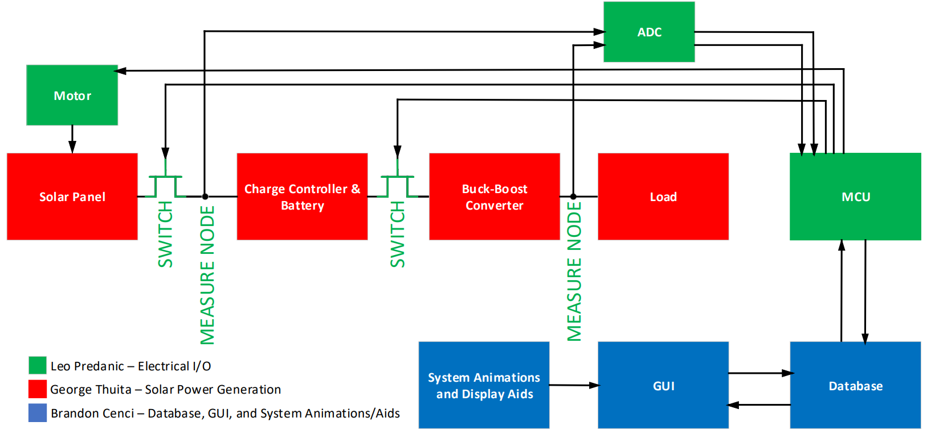
System Flow & Overview

Slide 4
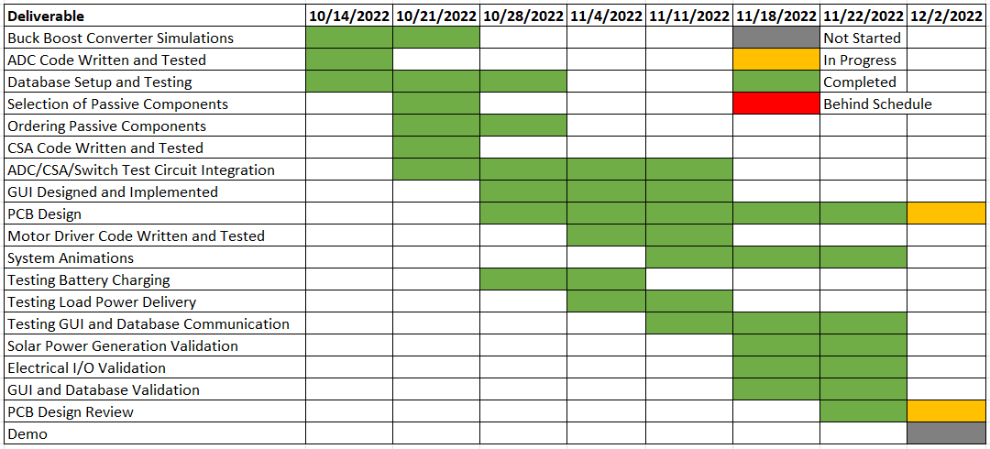
Execution
To be completed by:

Slide 5
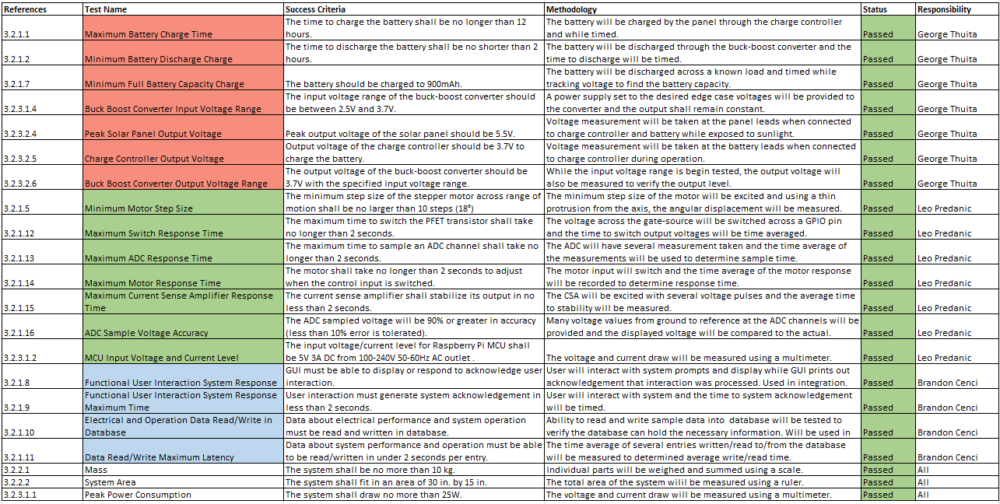
Validation

Slide 6
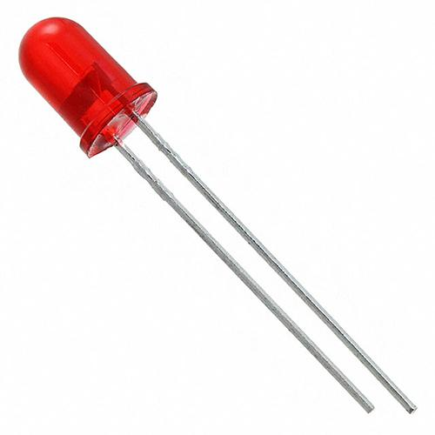
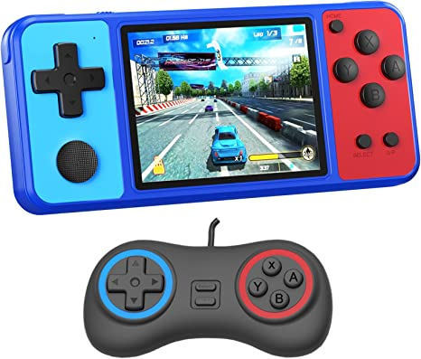
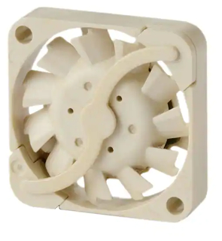
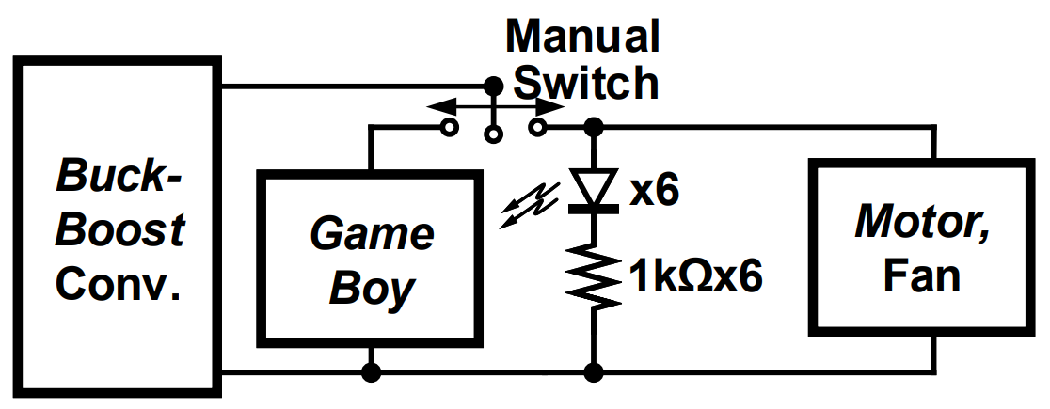
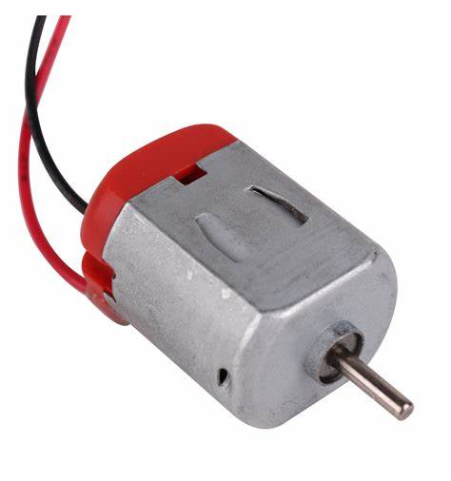
Solar Power Generation George Thuita
Accomplishments since the last presentation 40 hrs | Ongoing progress/problems and plans for 404
- Tested battery charging with charge controller - Tested buck-boost converter and load - Tested ‘GameBoy’ and regular load - Completing PCB Design | - PCB Design Review - Test components on board - Assist with additional integration tasks
Load:
Load Ckt.:
2.5V
600mA
3.7V
350mA
2.5V
350mA
3.7V
285mA
Input Power to Buck-Boost Converter:

Slide 7
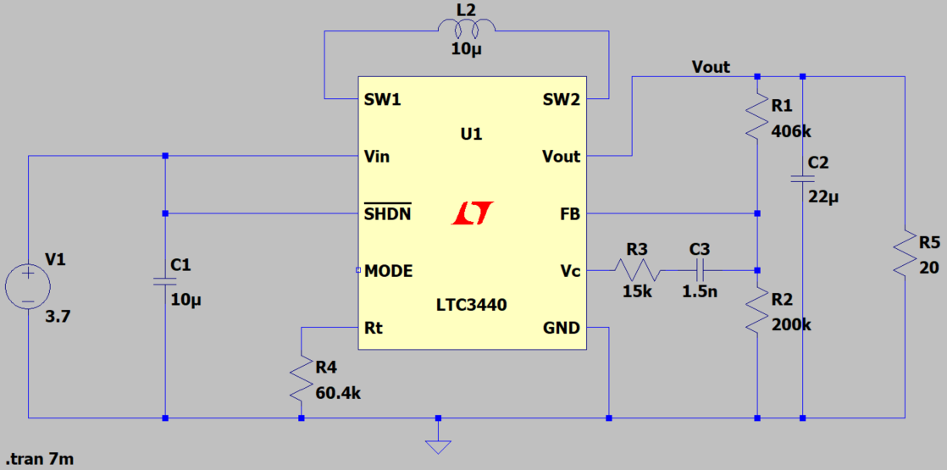
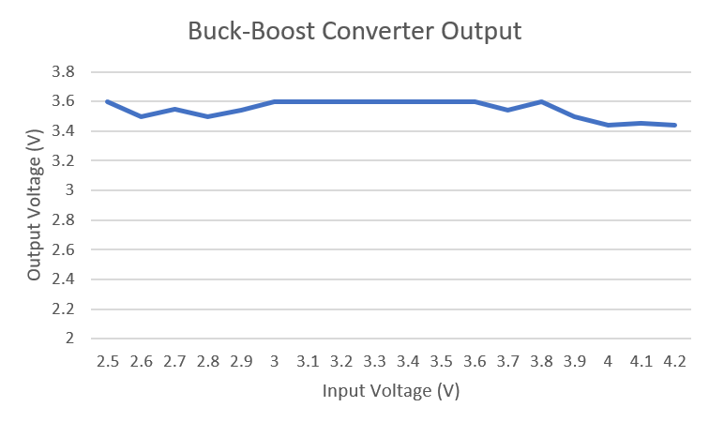
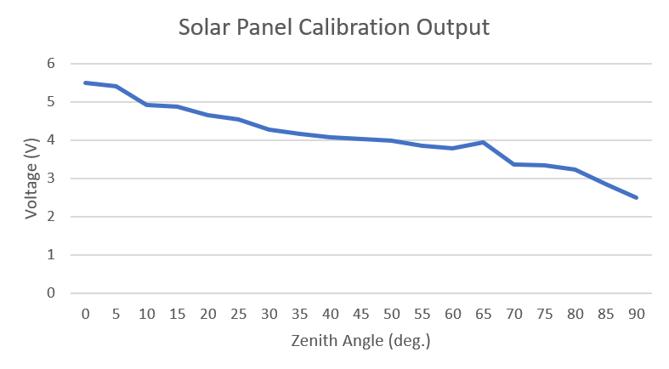
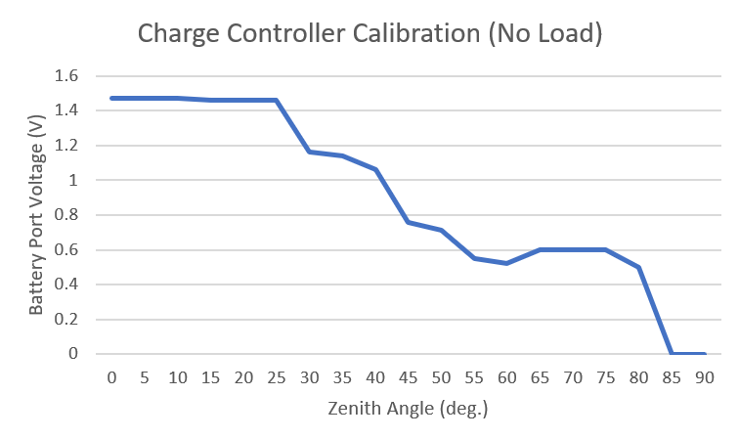
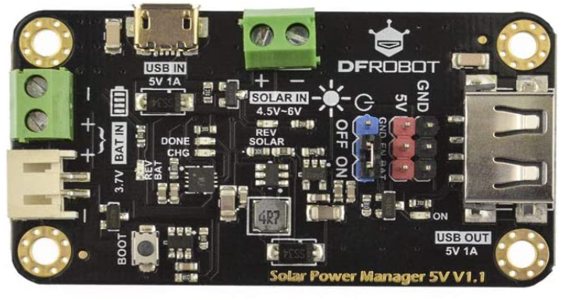
Solar Power Generation (2) George Thuita

Slide 8
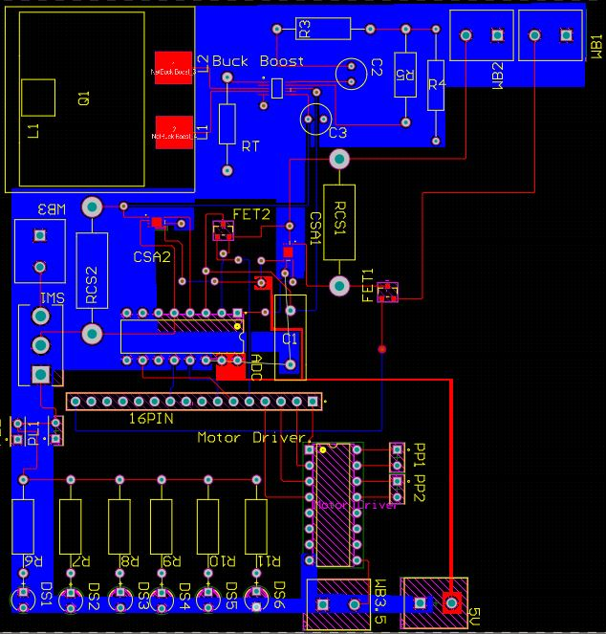
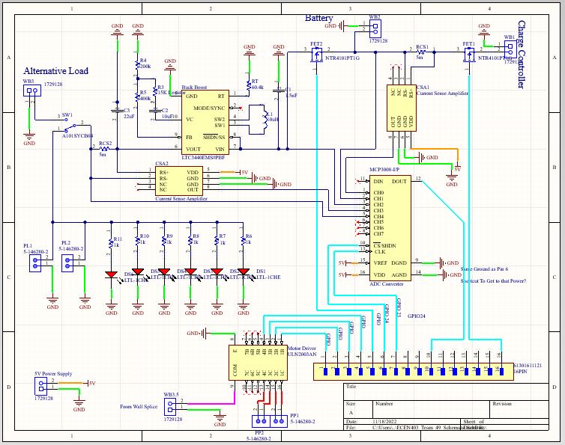
Solar Power Generation (3) George Thuita

Slide 9
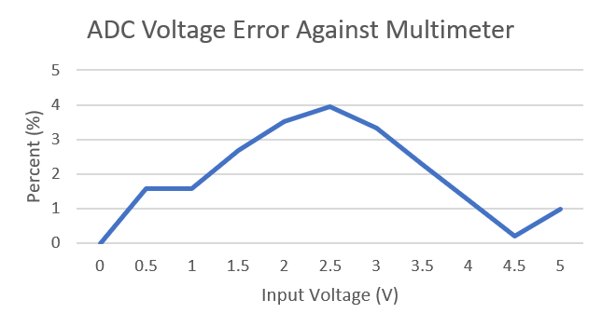
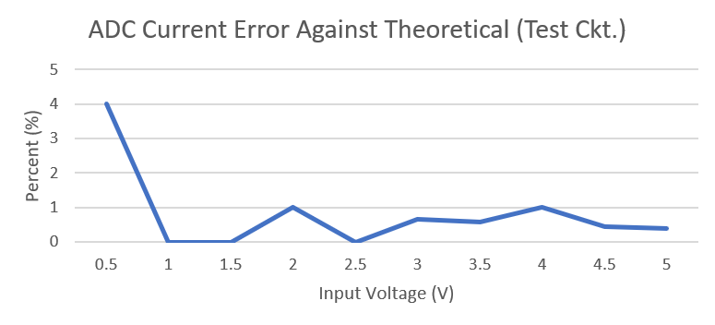
Electrical I/O Leo Predanic
Accomplishments since the last presentation 40 hrs | Ongoing progress/problems and plans for 404
- Calibration for electrical components - Code for power measurements - Added PFET switches in test circuit - Code for motor and tested operation - Assisted in test of power circuits | - Integration with GUI/database - Test subsystem with power generation subsystem on PCB - Full system motor and data output code - Possible level shifters for PFETs

Slide 10
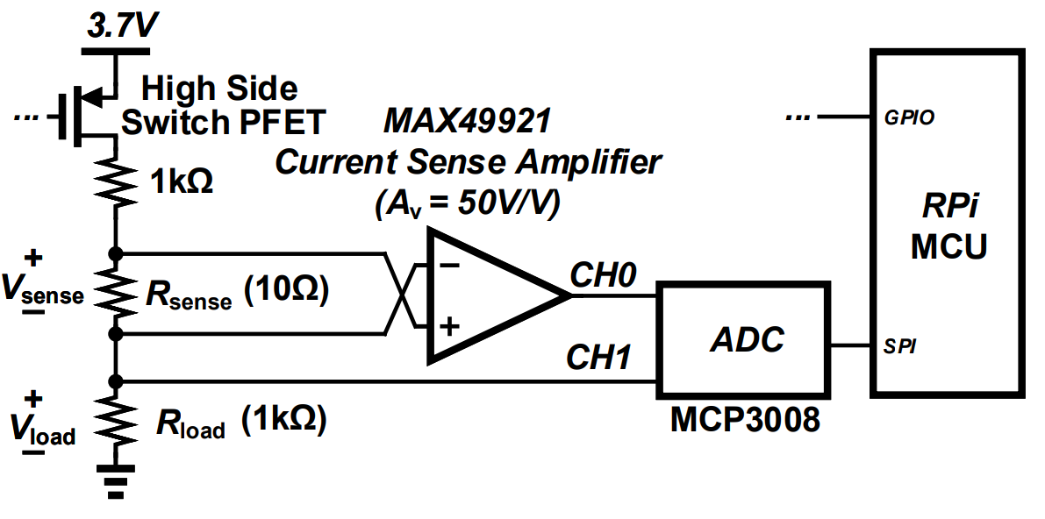
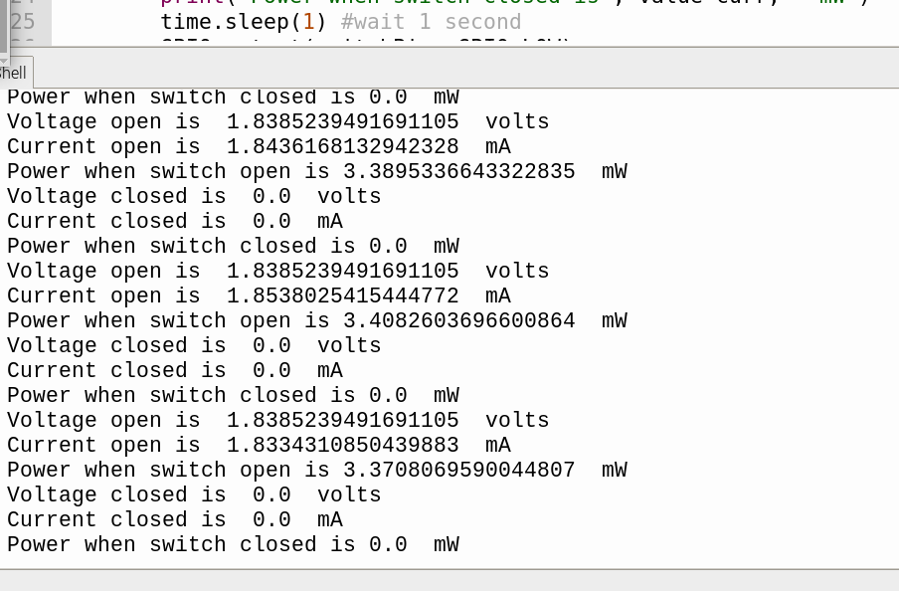
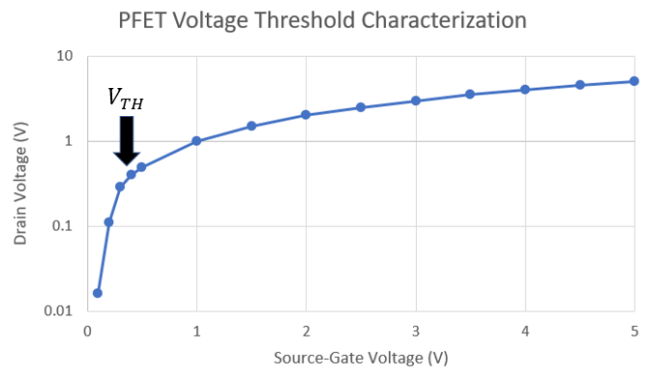
Electrical I/O (2) Leo Predanic

Slide 11
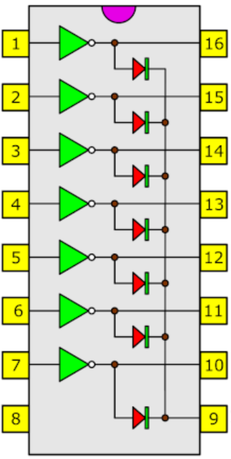
Electrical I/O (3) Leo Predanic
ULN2003
Phase1_Out
STEPPER MOTOR
Phase1_In
Phase2_Out
Phase2_In
Phase3_Out
Phase3_In
Phase4_Out
Phase4_In
COM
5V

Slide 12
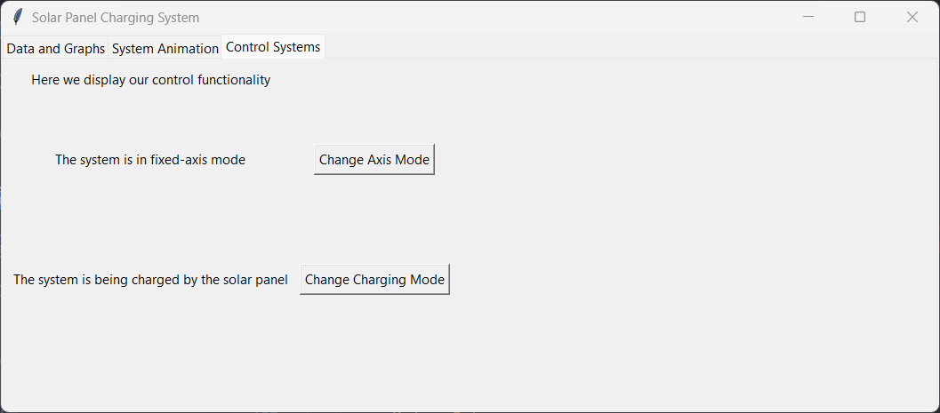
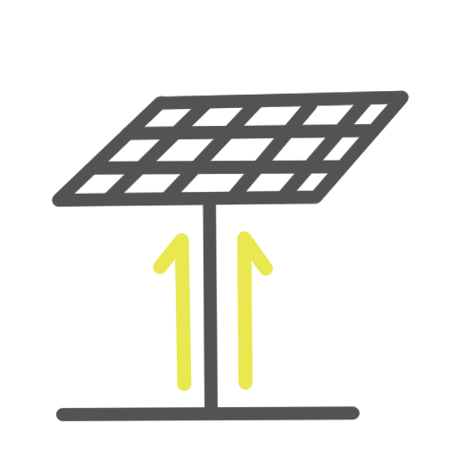
GUI and Database Brandon Cenci
Accomplishments since the last presentation 40 hrs | Ongoing progress/problems and plans for 404
-Created and validated GUI outline -Ensured proper communication between GUI and database -Created system animations -Implemented graphs and animations in GUI | - Ensure proper communication with other subsystems - Clean up GUI and improve design quality - Add additional functionality as needed - 3D printing chassis and panel stand

Slide 13
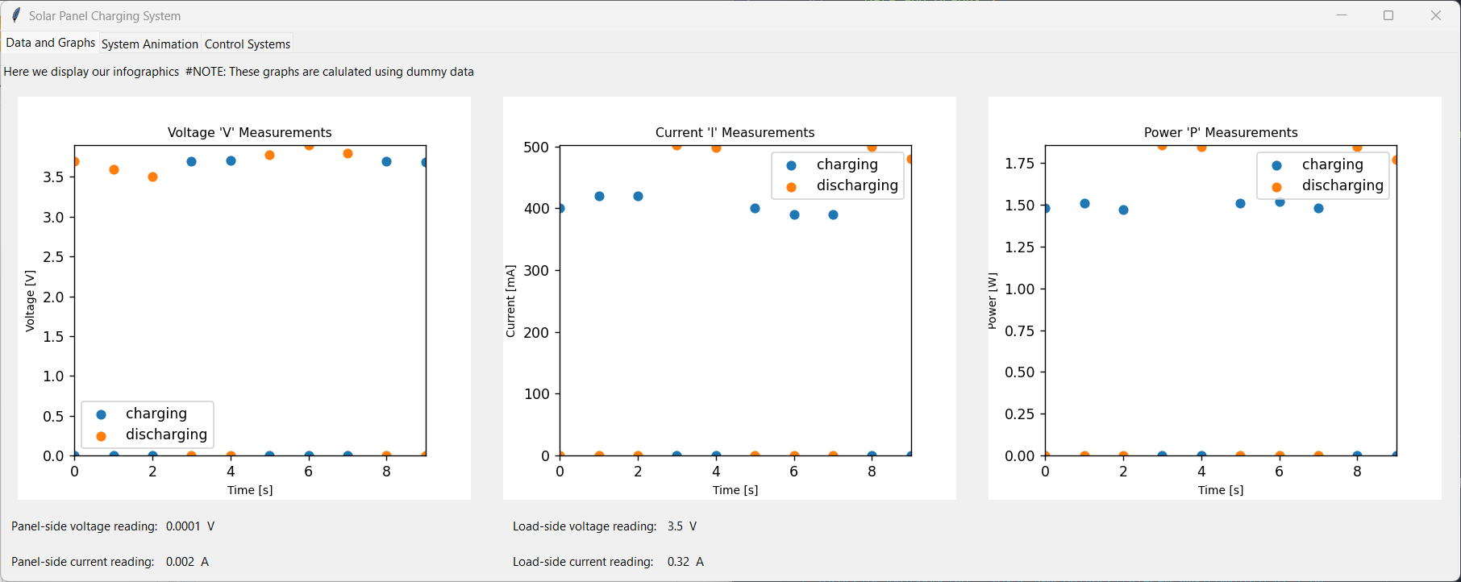
GUI and Database (2) Brandon Cenci
Infographics Tab
Displays voltage, current, and power measurements from database
Monitors real-time voltage and current readings

Slide 14
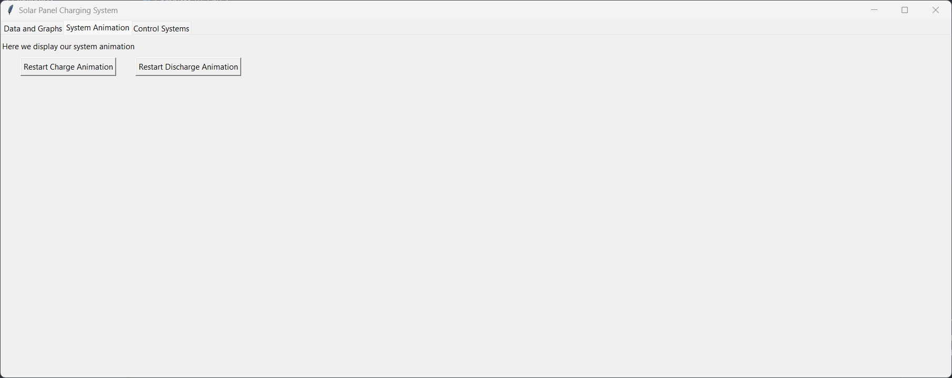
GUI and Database (3) Brandon Cenci
Animations Tab
Displays system animations for both discharging/charging modes
Allows for user control to trigger/restart animations

Slide 15
Questions?

